Slide 1

THE HOUSE ALWAYS WINS…
...most of the time
Exploratory Data Analysis – Sports Betting, Strategies, Full Analysis by Sports, Leagues and Teams
https://public.tableau.com/profile/api/publish/ComparisonLeaguesWINStraight/Story1

Slide 2
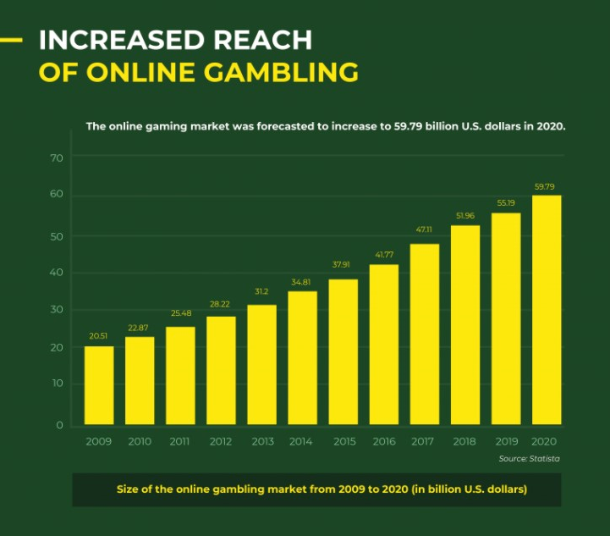
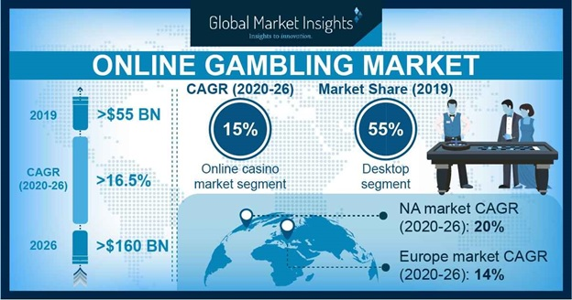
Introduction - Hypothesis
The availablity of “apps” and online betting have grown bookmakers or “bookies” into powerful worldwide companies.
The world of sports betting continues to grow, adapting to the many different types of customers, covers numerous different markets and can be separated into simple bets or accumulator bets.
All of these different options make it very difficult for casual users to decide on a strategy and therefore makes it easier for bookies to adjust their prices on popular markets to guarantee an overall profit.
The purpose of this EDA is to determine which markets are statistically easier to predict and which markets have the worst return for consumers.

Slide 3

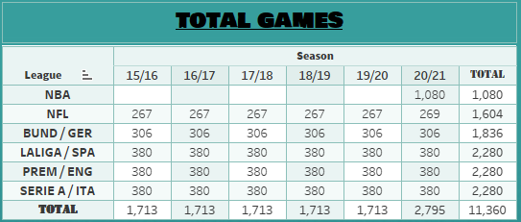
Index
1. What are the main markets in sports betting?
2. Overview of the data analysed
3. Well Known Teams vs Less Know Teams
4. Football Scattergraph
5. NBA review
6. Conclusions
178 TEAMS

Slide 4

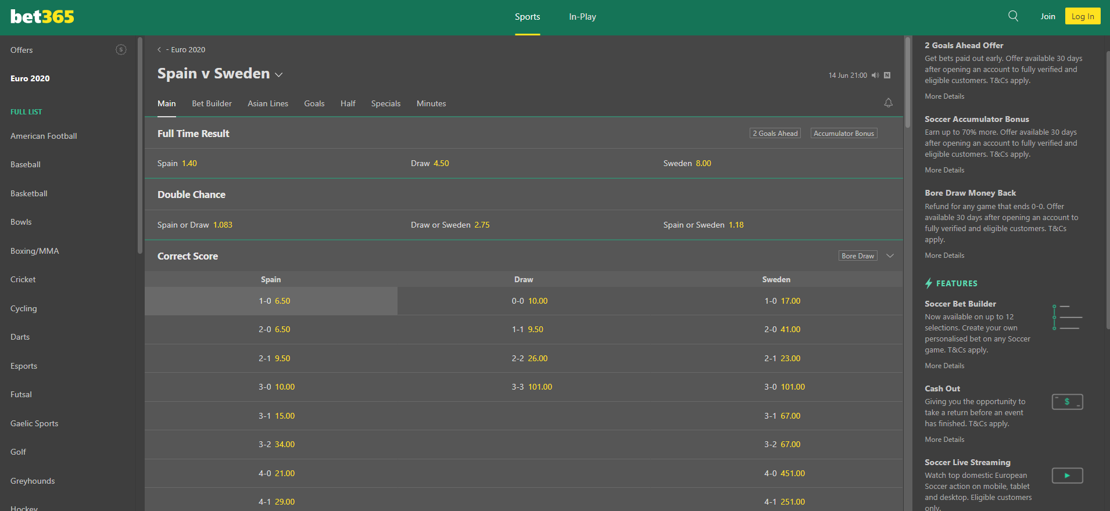

What are the main markets in sports betting?
Offers
To Win
Markets Available

Slide 5

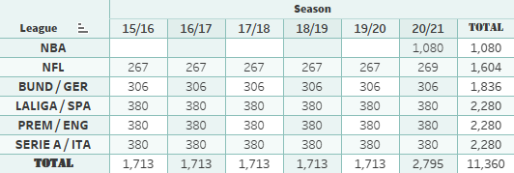
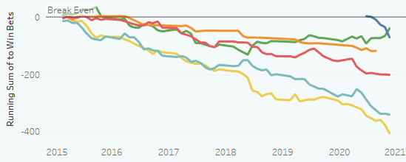
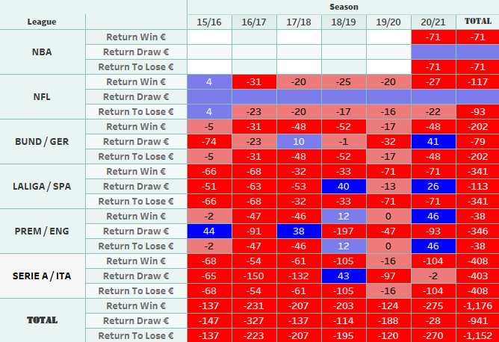
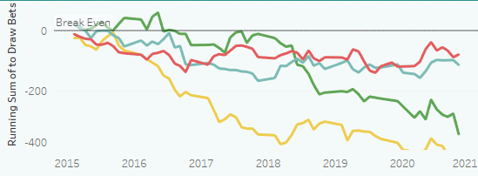
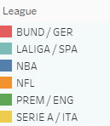
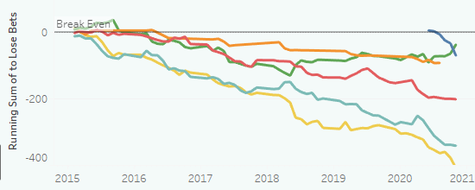
Overview of the data analysed
To Win
To Draw
To Lose

Slide 6

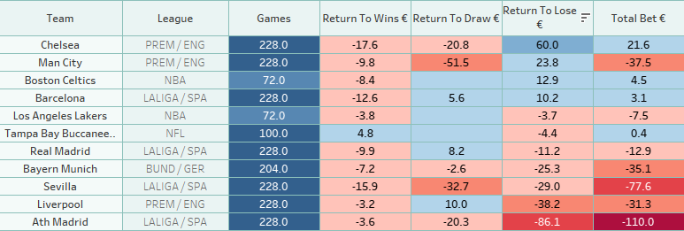
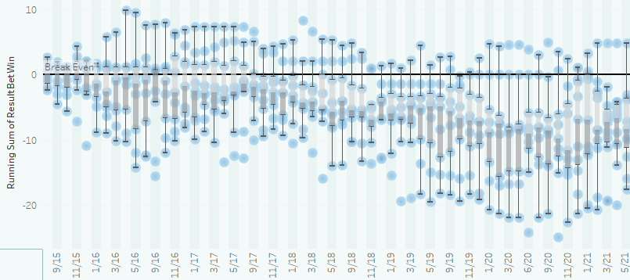
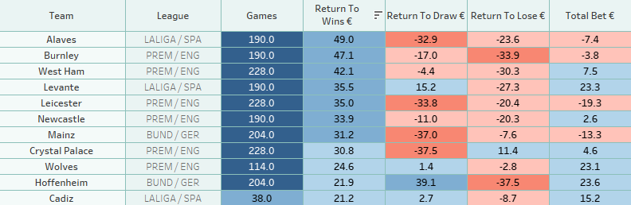
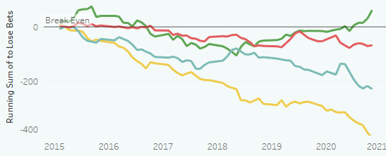
Well Known Teams vs Less Know Teams

Slide 7

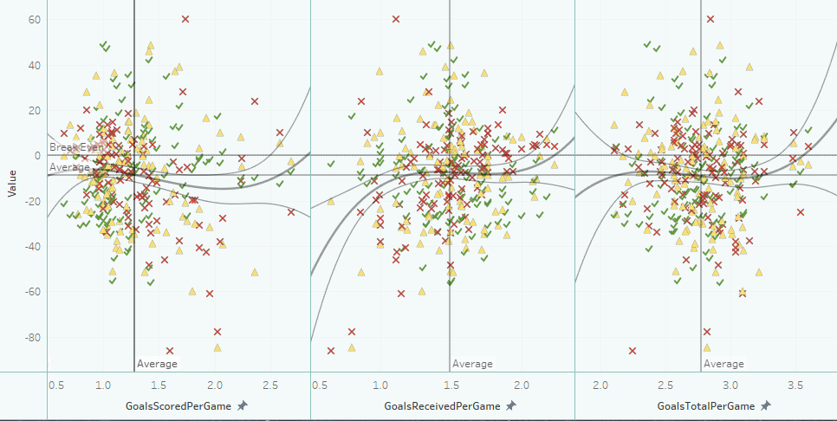

Football Scattergraph

Slide 8

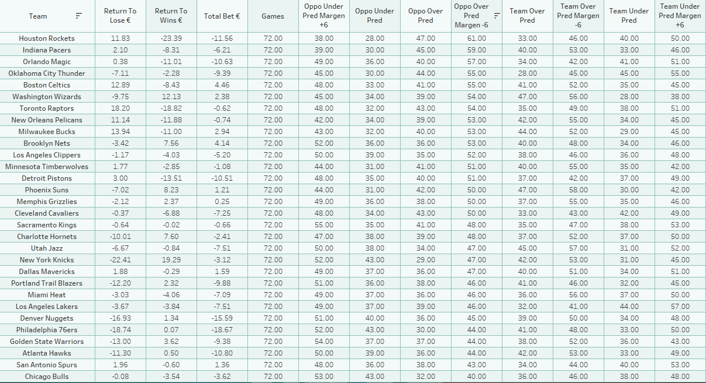


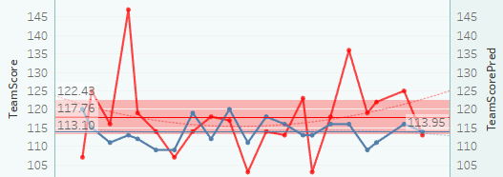
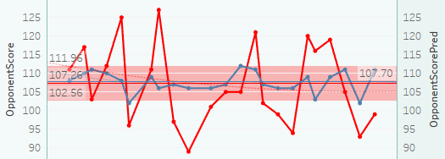
NBA review

Slide 9

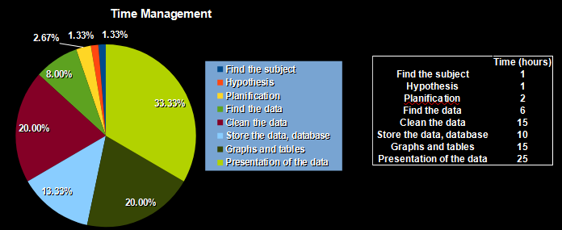
Conclusion
Sports Betting is unpredictable and
the markets are well controlled to guarantee a profit for the bookmakers.
Well known teams are statistically less likely to give you a return on your investment than less popular teams over the short and long term.
Of the areas analysed, points betting in the NBA is where more correlations are present between each teams recent form and their final results.

Slide 10

Thank you.
Any Questions?
Daniel Jonathan Walker
Data Science Student @TheBridge, Madrid, Spain
danielwalker1987.DW@gmail.com
https://www.linkedin.com/in/daniel-jonathan-walker-2a5a461b5/

